Slide 1
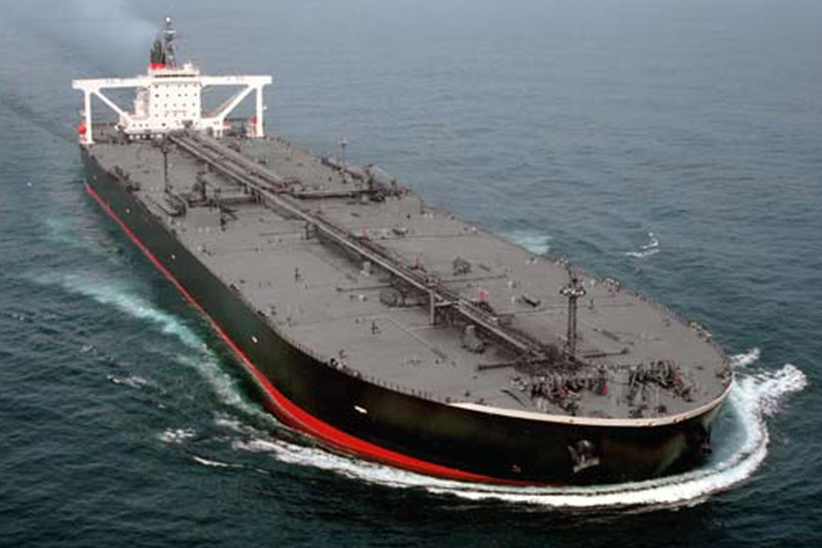
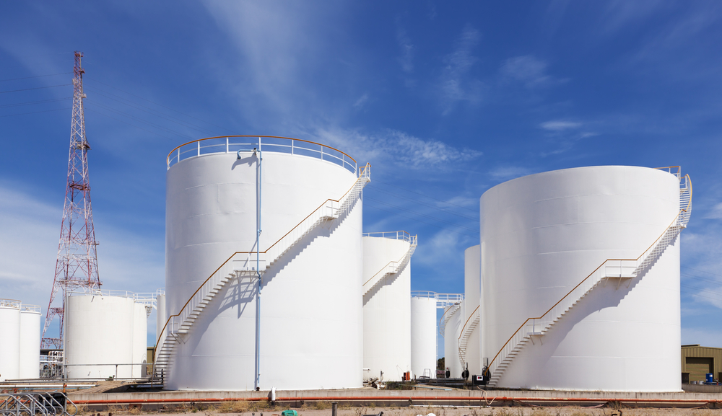
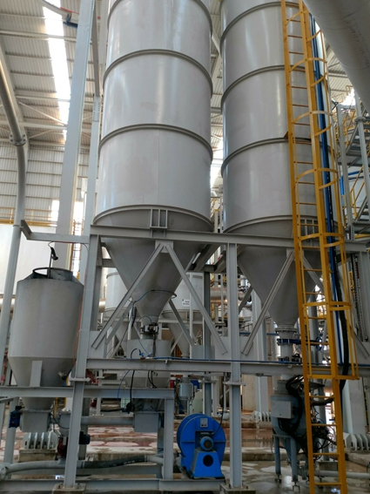
VESCON SHIPPING & CONSULTANCY
GAS MONITORING SYSTEM
GTS50

Slide 2
INTENDED AREAS OF USE FOR GTS50 SYSTEM;
IN SHIPYARDS, TANKERS,
IN NEW SHIPS CONSTRUCTIONS,
IN SHIPS IN REPAIR ZONES,
IN WORKS AND FACILITIES WHERE PERIODIC MEASUREMENTS ARE REQUIRED.

Slide 3
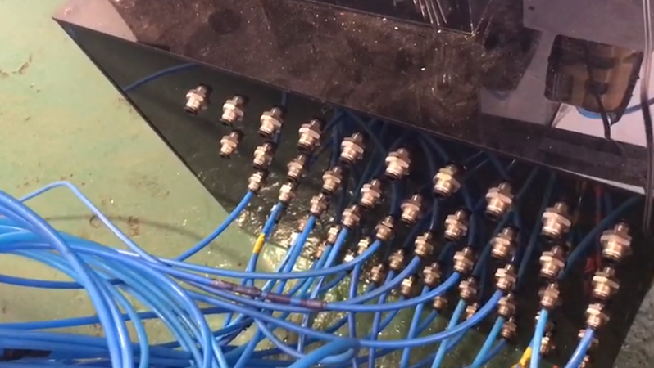
GTS50 SYSTEM
This system is designed to display regularly and periodically measured gas values and to allow intervention when necessary.

Slide 4
GTS50 SYSTEM
In the tankers which are repaired in the shipyard, samples are taken from the lower-middle and upper sections of the tank for a certain period of time, this period can be changed. (Tested for 130 seconds -No:1 CT is approx. 200 meter - 130 seconds)

Slide 5
GTS50 SYSTEM
In the facilities; it is placed in a suitable place where the storage tanks are located, the measurement for multiple tanks can be periodically displayed during cleaning and maintenance.

Slide 6
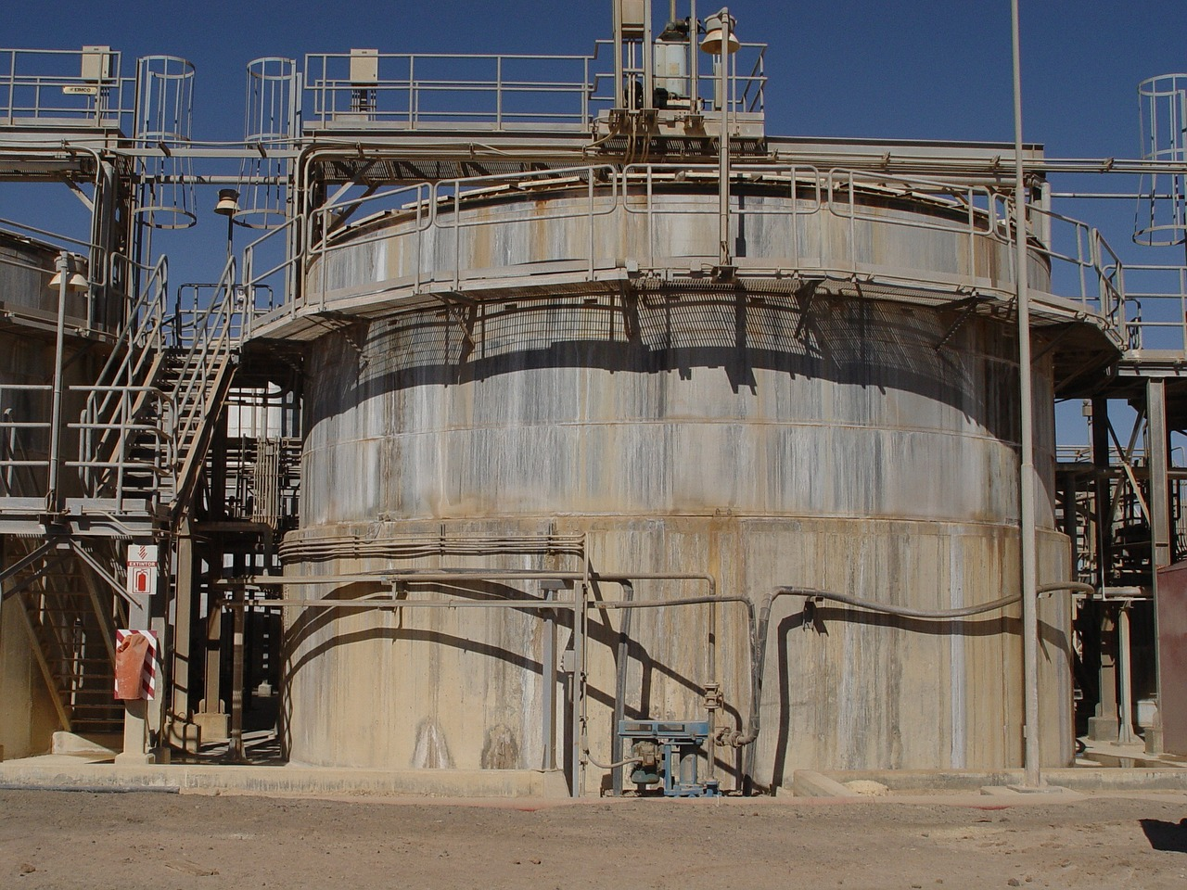
GTS50 SYSTEM
In factories and facilities; any sensor can be changed and required gas values can be measured periodically from certain locations.

Slide 7
It is designed to take samples respectively from the upper, middle and lower sections of the tank.
TANK 1
TANK 2
8MM-6MM
HOSES
SOLENOID VALVE
ASSEMBLY
GAS MEASUREMENT DEVICE

Slide 8
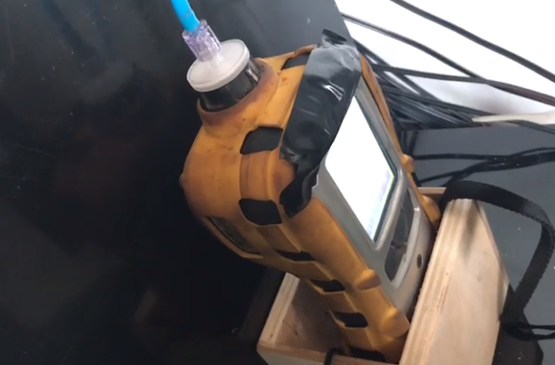
Multi Rae Lite device is used in the testing phase and it is operated for 8-10 hours a day and tested in a tanker in a shipyard during repair for 15 days.

Slide 9
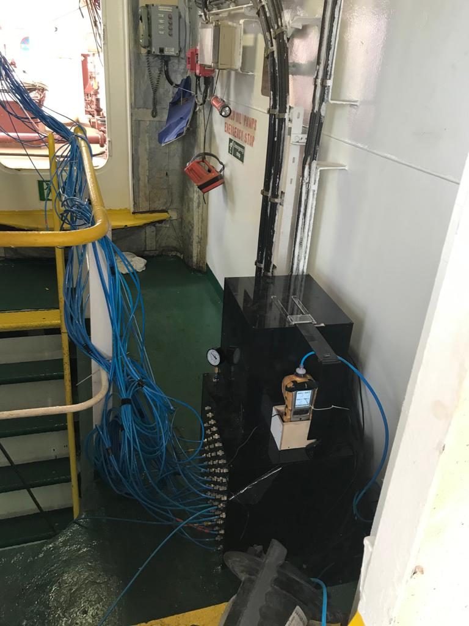
There are 50 ports of the system, 2 of which are used for testing purposes,
(Measurements can be made for up to 16 tanks. It is devised to have 3 ports per tank) number of ports can be increased.
When the system starts operating, it takes sample from Port No. 1 and continues to take samples in sequence until the system is turned off. (1, 2, 3, 4, …, 48, 1, 2, ...)

Slide 10
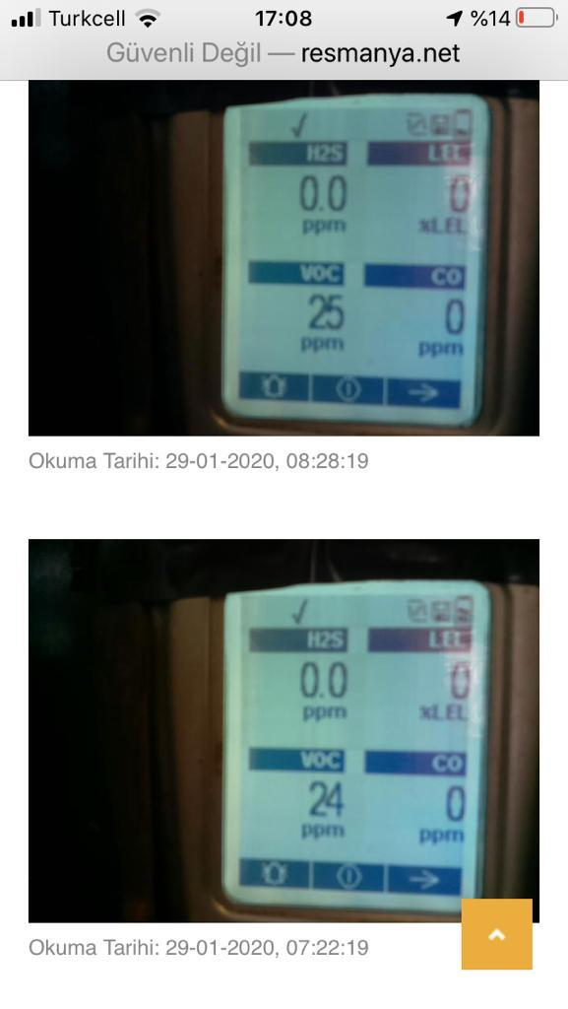
After sampling, the values displayed on gas measurement device are captured and uploaded to the specified website. It is possible to view at which date and time gas measurements are made.
The display is refreshed every 60 seconds.
The data are retained in the system memory for 3 months.

Slide 11
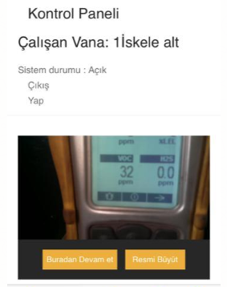
The values can be viewed and controlled on a computer or on a phone typing the user name and password into the system.
Any tank can be measured individually.
When authorized personnel clicks on "Resume" button on control panel, values are started to be displayed for that tank and measurements are continued for the next tanks.
(In a normal cycle, if number 4 is pressed, tank No. 4 is measured, then measurements are continued in ascending order. (4, 5, 6, 7, ..., 48, 1, 2, ...)

Slide 12
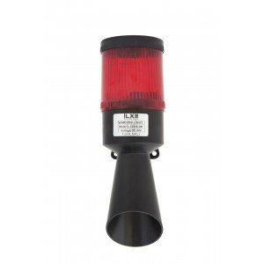
An audio and light alarm is triggered based on values at the end of the measurement.

Slide 13
DESIGNED BY
Halil ZAFER BÜYÜKEVREN
Gemi Makinaları İşletme Mühendisi
Gas-Free Certification Expert
Phone:
+90 533 710 79 11
E-mail:
www.vesconshipping.com
info@vesconshipping.com

